Slide 1
WINE QUALITY ANALYSIS
SUBMITTED BY:-
CH.CHAKRAPANI(18071A0570)
B.SHASHIDHAR(18071A0562)
K.NIKHIL(18071A0584)
B.KRANTHI(19075A0507)
UNDER THE GUIDANCE OF
Mrs.L.Indira (Asst.professor CSE,VNR VJIET)

Slide 2
ABSTRACT
Wine classification is a difficult task since taste is the least understood of the human senses. A good wine quality prediction can be very useful in the certification phase, since currently the sensory analysis is performed by human tasters, being clearly a subjective approach. An automatic predictive system can be integrated into a decision support system, helping the speed and quality of the performance. Furthermore, a feature selection process can help to analyze the impact of the analytical tests. If it is concluded that several input variables are highly relevant to predict the wine quality, since in the production process some variables can be controlled, this information can be used to improve the wine quality. Classification models used here are 1) Random Forest 2) Support Vector Machine(SVM) 3) Decision Tree

Slide 3
INTRODUCTION
The aim of this project is to predict the quality of wine on a scale of 0–10 given a set of features as inputs. The dataset used is Wine Quality Data set from UCI Machine Learning Repository. Input variables are fixed acidity, volatile acidity, citric acid, residual sugar, chlorides, free sulphur dioxide, total sulphur dioxide, density, pH, sulphates, alcohol. And the output variable is quality (score between 0 and 10).We are dealing only with red wine. We have quality being one of these values: [3, 4, 5, 6, 7, 8]. The higher the value the better the quality.

Slide 4
OBJECTIVE
Data Preparation:divide quality score into 3 different categories such as best, good, bad.
A large dataset is considered and wine quality is modelled to analyse the quality of wine through different parameters like fixed acidity,volatile acidity etc.
Our main object is to predict the wine quality using machine learning through python progamming language.
It can support the wine expert evaluations and ultimately improve the production.
This model could also be used to improve the training of oenology (science and study of wine and winemaking) students.

Slide 5
LITERATURE REVIEW
Conference paper -Paulo Cortez , Juliana Teixeira , Ant´onio Cerdeira, Fernando Almeida , Telmo Matos , and Jos´e Reis “Using Data Mining for Wine Quality Assessment” Discovery Science, 12th International Conference, DS 2009, Porto, Portugal, October 3-5, 2009.
Journal -Devika Pawar ,Aakansha Mahajan, Sachin Bhoithe “Wine Quality Prediction using Machine Learning Algorithms ” International Journal of Computer Applications Technology and Research Volume 8–Issue 09, 385-388, 2019, ISSN:-2319–8656 December 21,2019.
Both conference paper and journal are about the prediction and assessment of wine quality which is so much related about our project.
The conclusions and processes from the paper and journal are taken as reference and applied in our project

Slide 6
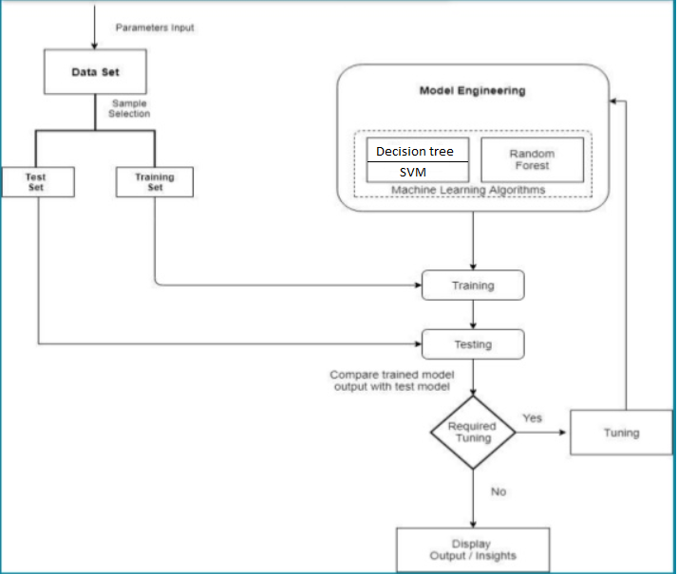
ARCHITECTURAL MODEL

Slide 7
HARDWARE AND SOFTWARE REQUIREMENTS
HARDWARE REQUIREMENTS:-
RAM:-4GB and higher
Processor:-intel i3 and above
Harddisk:-minimum 10GB
SOFTWARE REQUIREMENTS:-
Python
Jupyter notebook

Slide 8
Data Description
Input Variables
Fixed acidity
Volatile acidity
Citric acid
Residual sugar
Chlorides
Free sulphuric acid
Total sulphuric acid
Density
pH
Sulphates
alcohol
Output variable
quality

Slide 9
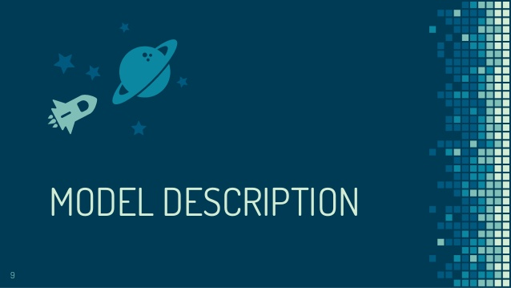

Slide 10
Machine learning models used…
Decision Tree Model
Random Forest Model
Support Vector Machine Model(SVM)

Slide 11
DECISION TREE
Decision tree learning is one of the predictive modelling approaches used in machine learning
It uses a decision tree (as a predictive model) to go from observations about an item (represented in the branches) to conclusions about the item's target value (represented in the leaves).
Simple to understand and interpret
Performs well with large datasets
Trees can be very non-robust
Problem of overfitting

Slide 12
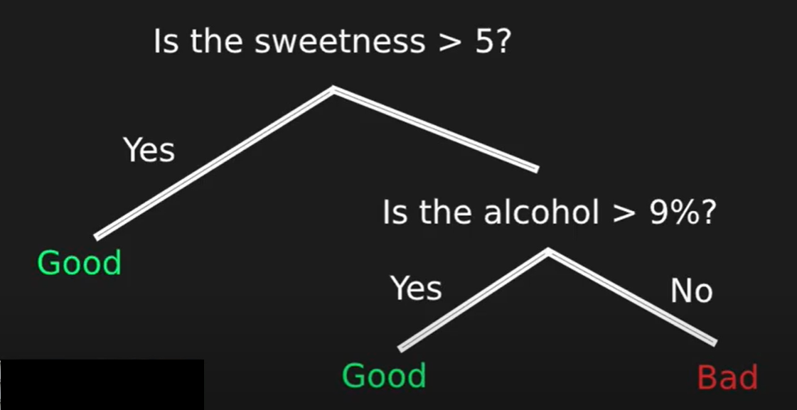
Representation of decision tree

Slide 13
Random Forest Model
A decision tree is built on an entire dataset, using all the features/variables of interest, whereas a random forest randomly selects observations/rows and specific features/variables to build multiple decision trees from and then averages the results.
Random Forest can automatically handle missing values.
Rare cases of overfitting
Random Forest require much more time to train as compared to decision trees as it generates a lot of trees

Slide 14
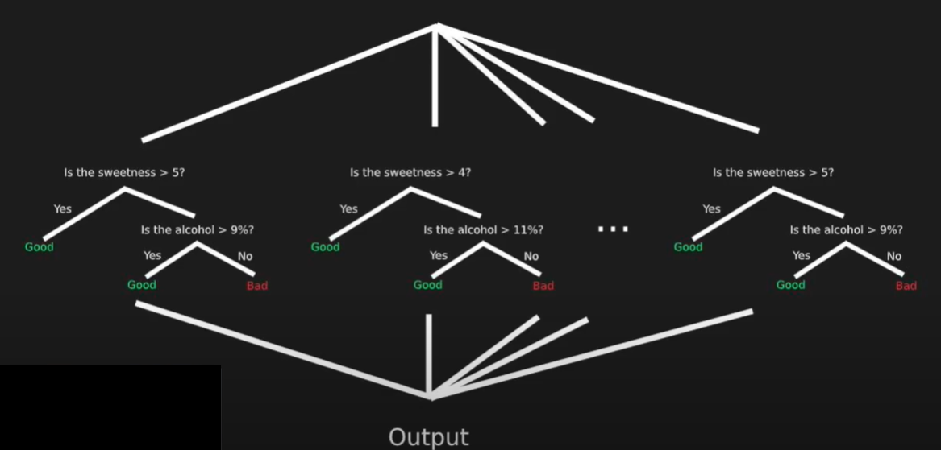
Representation of Random Forest

Slide 15
Support Vector Machine
The objective of the support vector machine algorithm is to find a hyperplane in an N-dimensional space that distinctly classifies the data points.
We use the help of support vectors to locate the data point (vector) in the plane
SVM works relatively well when there is clear margin of separation between classes.
SVM is more effective in high dimensional spaces.
SVM algorithm is not suitable for large data sets.

Slide 16
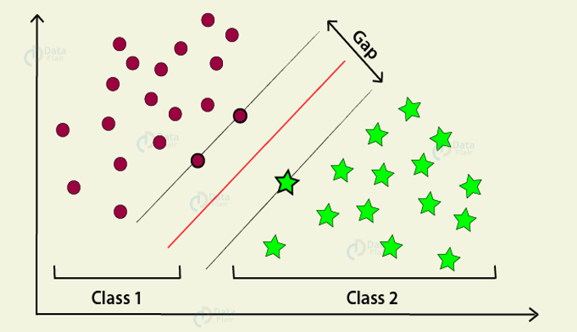
Representation of Support Vector Machine

Slide 17
Code and implementation

Slide 18
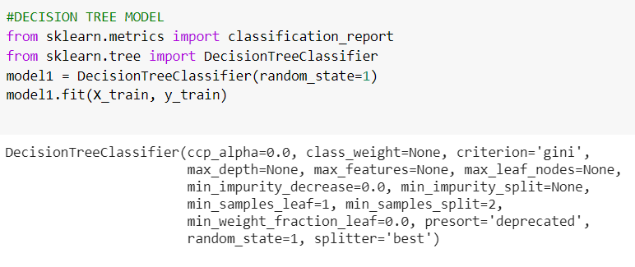
Training the decision tree

Slide 19
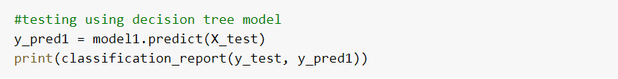
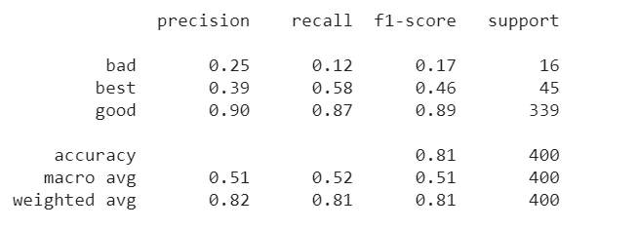
Testing and printing test report of decision Tree
Test report

Slide 20
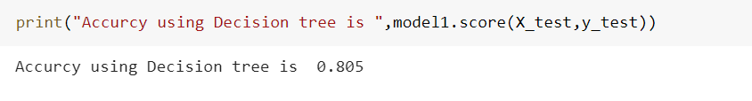
Accuracy of Decision Tree model
The accuracy of Decision Tree model is 80.5%

Slide 21
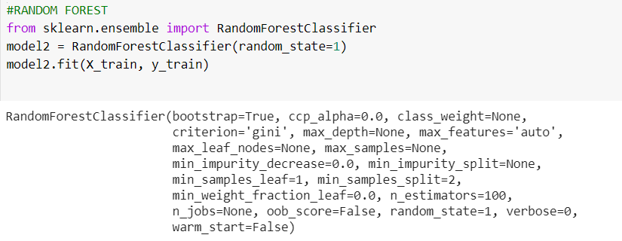
Traning the Random Forest Model

Slide 22
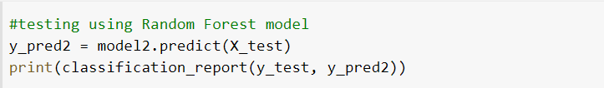
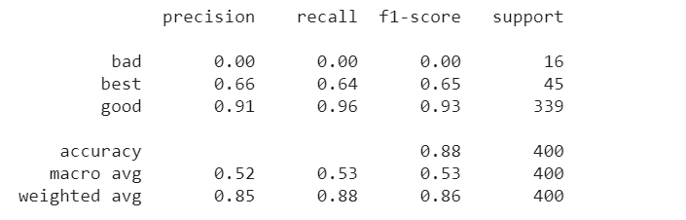
Testing and printing the test report of Random Forest
Test Report

Slide 23
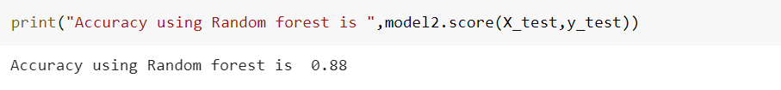
Accuracy of Random Forest Model
Accuracy of Random Forest Model is 88.0%

Slide 24
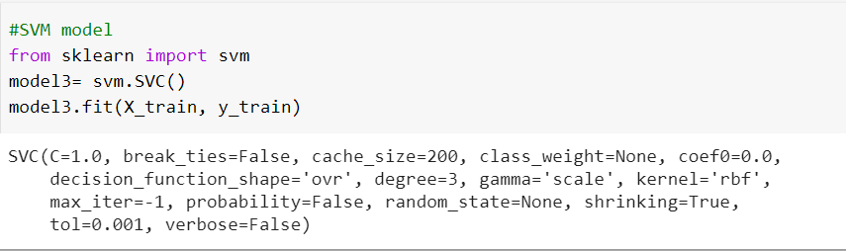
Training the SVM model

Slide 25
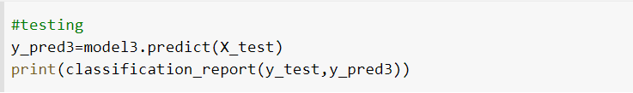
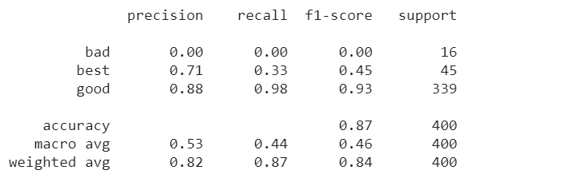
Testing and printing test report of SVM model
Test Report

Slide 26

Accuracy of SVM model
Accuracy of Support Vector Machine Model is 87.0%

Slide 27
Limitation and Future scope
Limitations are our model uses only structured data.
Wine quality can be improved by studying the relation between the input and output variable and relation among input variables.
If the data set has more records on both the low end and high end, the quality of analysis can be improved.

Slide 28
APPLICATIONS
This model can be a replacement to the team working on quality assessment.
This model could also be used to improve the training of oenology (science and study of wine and winemaking) students.
The graphs and conclusions from the correlation matrix can be used to improve the quality of wine.
Results can be used by consumers for wine selection.

Slide 29
CONCLUSION
We were able to achieve maximum accuracy using Random forest model of 88%.
Decision tree model giving an accuracy of 80.5%
Support Vector Machine(SVM) has an accuracy of 87%.

Slide 30
THANK YOU

